Slide 1
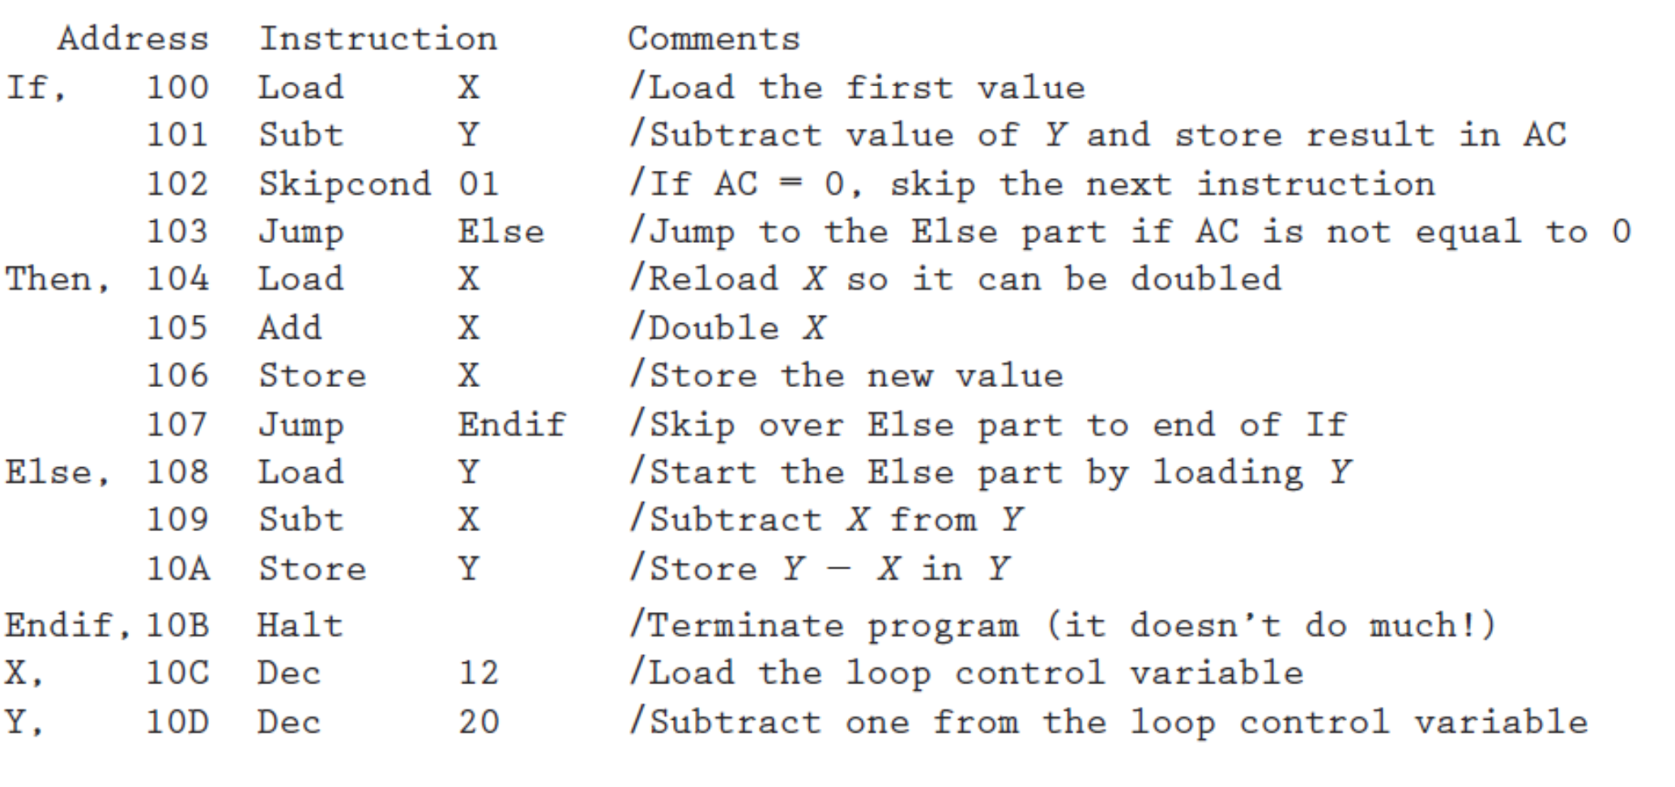

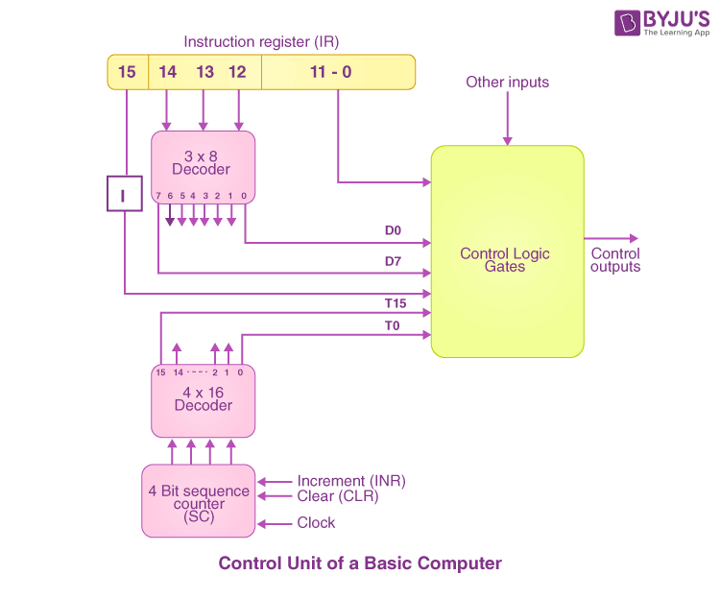
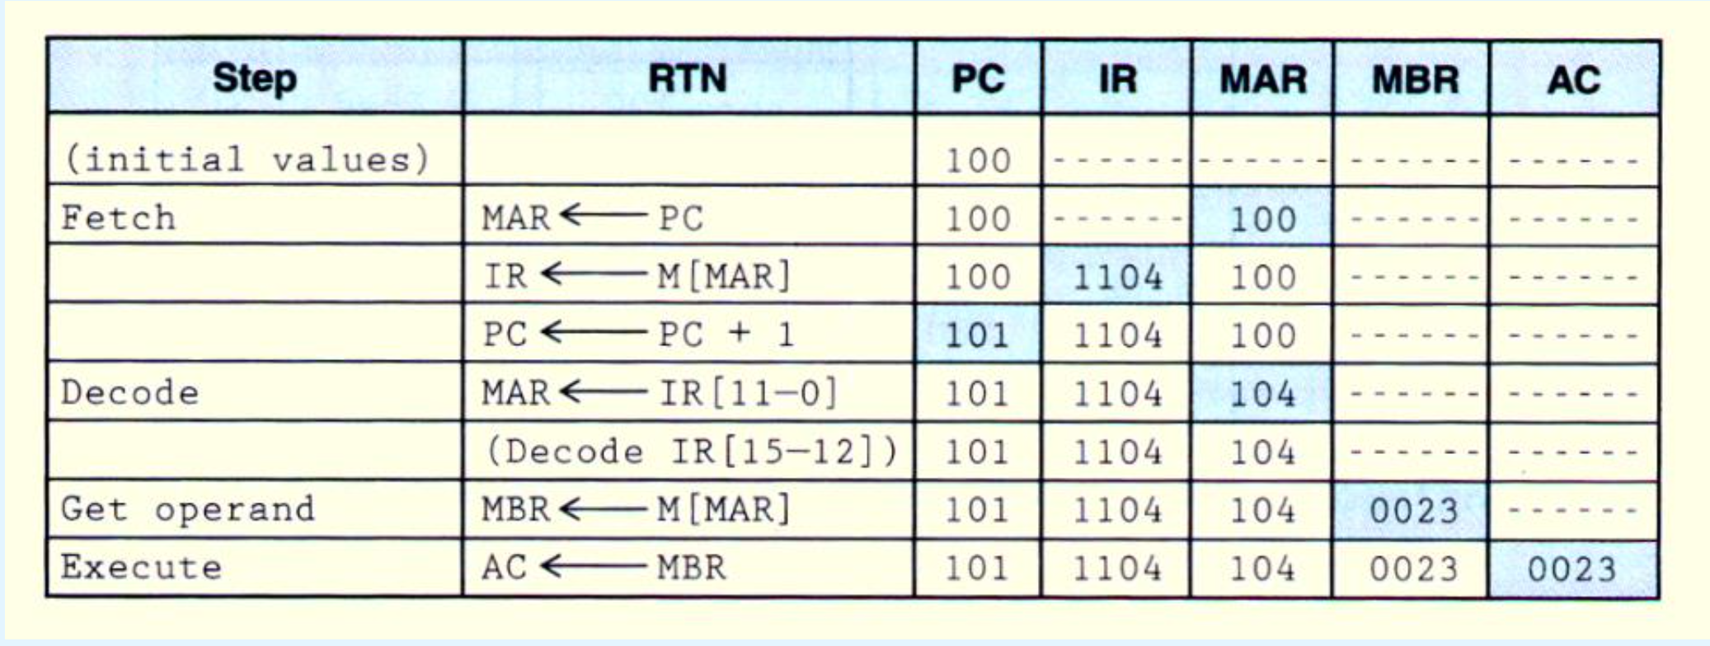
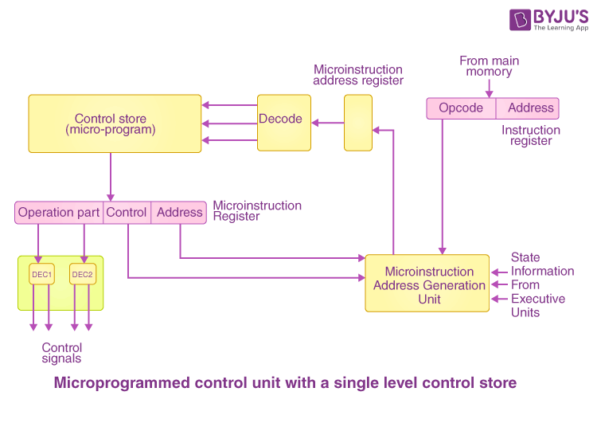
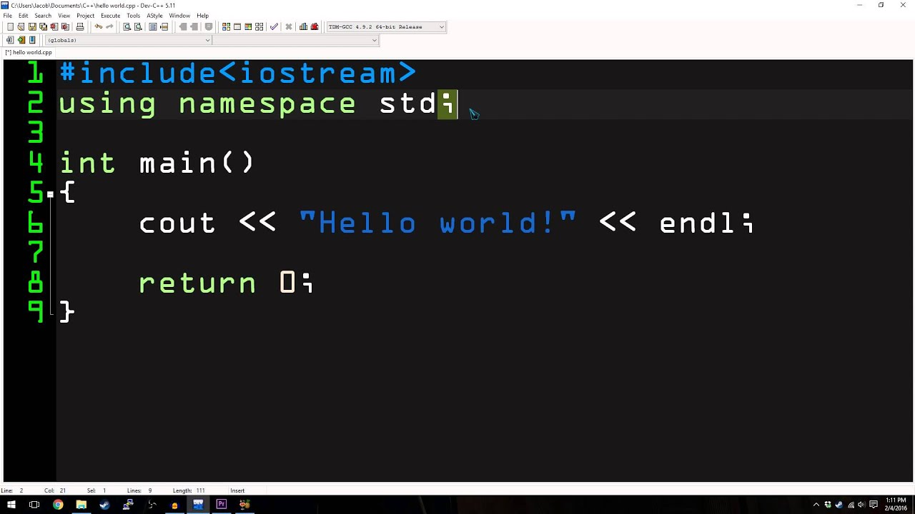
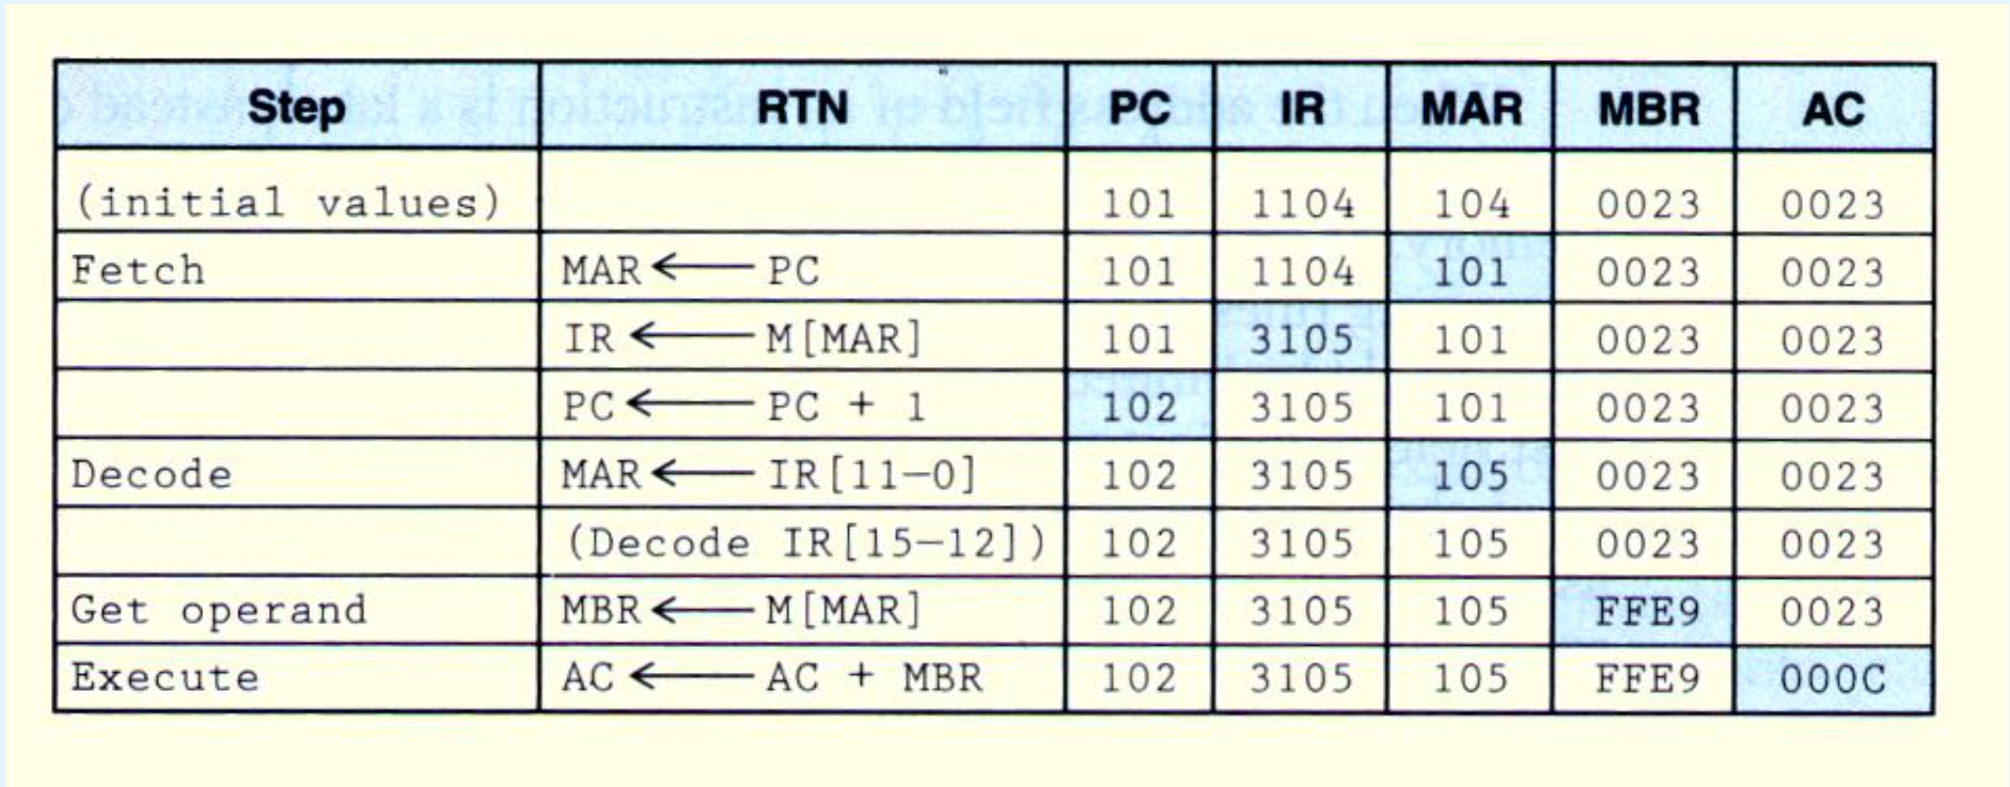
Computer
Bare Metal
Control Signals
(hardwired/microprogrammed)
(Circuit Level)
Microoperations
(in RTN, CPU Level)
Instructions
（defined by ISA, Computer Level）
Program
(Algorithm Level)
Software
(Service Level)
load 104
add 105

